Slide 1
Plotting in R
Use ggplot2

Slide 2
Plotting in R
Base plotting system
Default plotting system, comes installed with R
Two step process
Make plot
Add annotations
Lattice
Lattice package (https://cran.r-project.org/web/packages/lattice/index.html)
Plotting and annotations done as single function
Powerful for multivariate data
ggplot2
ggplot2 package (https://cran.r-project.org/web/packages/ggplot2/index.html)
Based on “The Grammar of Graphics”
More elegant graphing than either Base or Lattice

Slide 3
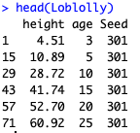
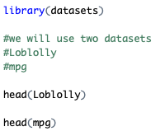
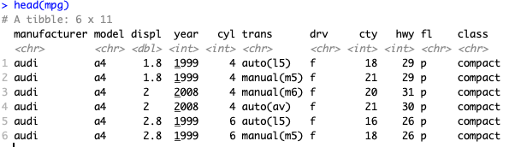
Load some data

Slide 4
Plot height vs age from Loblolly
Base Package .... Eww

Slide 5
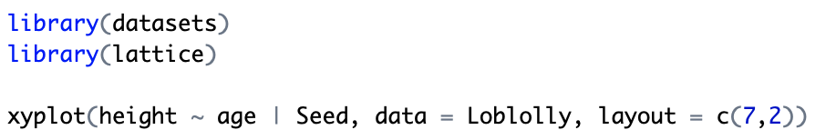
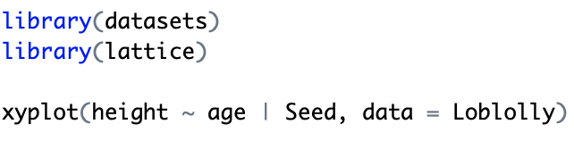
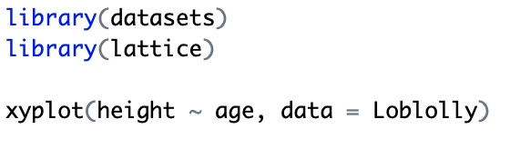
Lattice

Slide 6
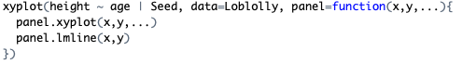
Panel functions

Slide 7
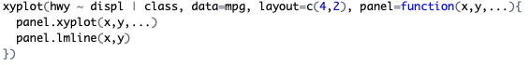
Try to make this graph

Slide 8
ggplot2
Grammer of Graphics
Book by Leland Wilkinson
Attempts to create a “language” of graphics
Basic elements of a graph are like words
These can be pieced together to create plots
Incredibly flexible
This philosophy of graphics implemented in ggplot, later ggplot2
created by Hadley Wickham

Slide 9
ggplot2
(Points, lines, bars, etc)
Geometric Objects
MAPPING
Data
Aesthetics
(color, shape, size)

Slide 10
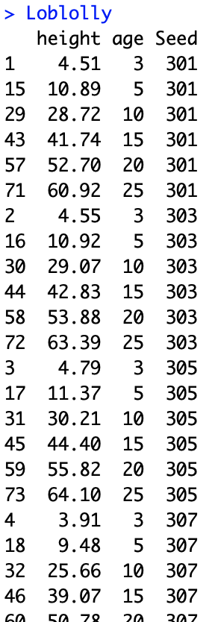
Defining the data
ggplot()
The primary function -> looks for the data
Add geometric objects ”geom” after
qplot()
”quick plot”
calls ggplot()
Equivalent to “plot()” in Base package
Data needs to be organized in a dataframe

Slide 11
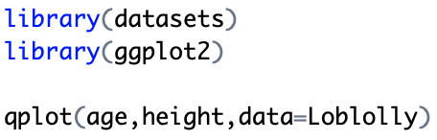
qplot()

Slide 12
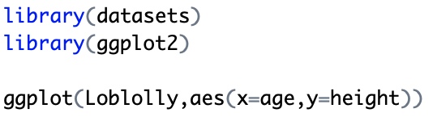
ggplot()
Define aesthetics “aes”
Plot is empty because you have not
defined the geometric object

Slide 13
Aesthetics
More than just how a plot looks, can be used convey data
placed within ”aes()”
Can be defined in ggplot() or the geom
Common aesthetics (there are others)
X
Y
group
color
fill
size
shape

Slide 14
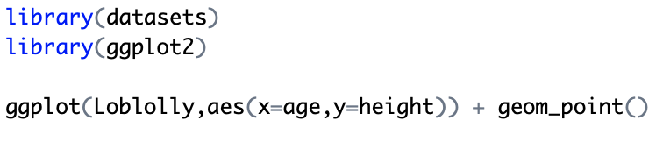
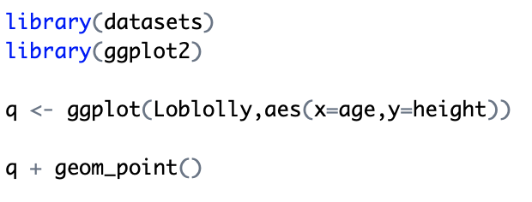
Geometric objects ”geom"
Add geometric object “geom_point()”

Slide 15
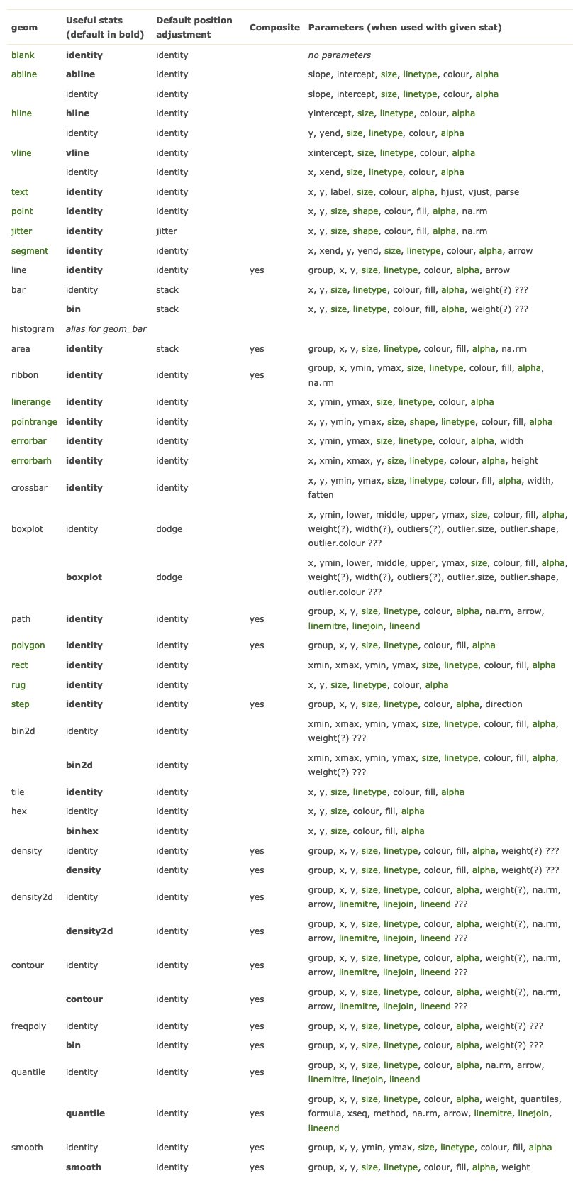
Geometric objects “geoms”
~33 geometric objects
Format: “geom_XXXXX()”
e.g. “geom_boxplot()”
These can be combined “layered” in one graph to create new visualizations
Each has it’s own parameters

Slide 16
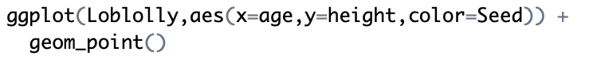
Using aesthetics to convey data

Slide 17
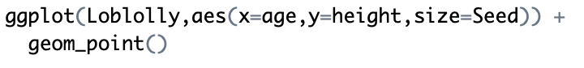
Using aesthetics to convey data

Slide 18
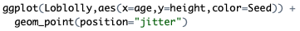
position

Slide 19
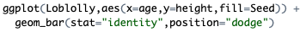
Try to make this graph

Slide 20
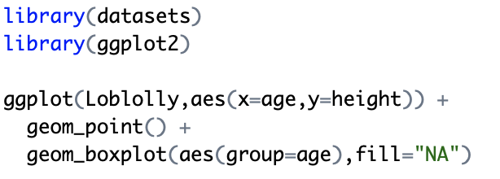
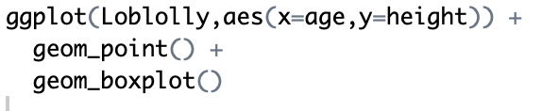
Layering geometric objects

Slide 21
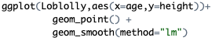
Layering geometric objects

Slide 22
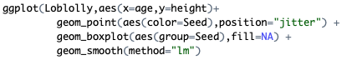
Try to make this graph

Slide 23
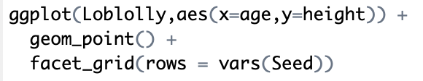
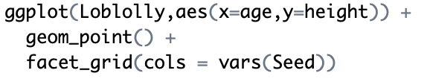
facet_grid()

Slide 24
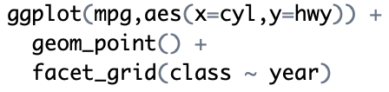
facet_grid()

Slide 25
I need a break

Slide 26
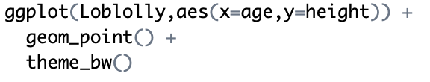
Step 4: Changing Themes
theme()
use to tweak visual aspects of graph other than data
Other standard themes available
e.g. “theme_bw()”

Slide 27
themes: each defines some aspect of the graph that can be modified
theme(line, rect, text, title, aspect.ratio, axis.title, axis.title.x, axis.title.x.top, axis.title.x.bottom, axis.title.y, axis.title.y.left, axis.title.y.right, axis.text, axis.text.x, axis.text.x.top, axis.text.x.bottom, axis.text.y, axis.text.y.left, axis.text.y.right, axis.ticks, axis.ticks.x, axis.ticks.x.top, axis.ticks.x.bottom, axis.ticks.y, axis.ticks.y.left, axis.ticks.y.right, axis.ticks.length, axis.line, axis.line.x, axis.line.x.top, axis.line.x.bottom, axis.line.y, axis.line.y.left, axis.line.y.right, legend.background, legend.margin, legend.spacing, legend.spacing.x, legend.spacing.y, legend.key, legend.key.size, legend.key.height, legend.key.width, legend.text, legend.text.align, legend.title, legend.title.align, legend.position, legend.direction, legend.justification, legend.box, legend.box.just, legend.box.margin, legend.box.background, legend.box.spacing, panel.background, panel.border, panel.spacing, panel.spacing.x, panel.spacing.y, panel.grid, panel.grid.major, panel.grid.minor, panel.grid.major.x, panel.grid.major.y, panel.grid.minor.x, panel.grid.minor.y, panel.ontop, plot.background, plot.title, plot.subtitle, plot.caption, plot.tag, plot.tag.position, plot.margin, strip.background, strip.background.x, strip.background.y, strip.placement, strip.text, strip.text.x, strip.text.y, strip.switch.pad.grid, strip.switch.pad.wrap, ..., complete = FALSE, validate = TRUE)

Slide 28
Elements
ggplot2 themes have “elements” for non-data components
element_blank() -> sets it to empty
element_rect() -> borders and backgrounds
element_line() -> lines
element_text() -> text
For each theme, you can modify using these four elements
theme(axis.text=element_text(color=“blue”))
theme(line=element_line(size=5))
theme(axis.text=element_text(color=“blue”), line=element_line(size=5))

Slide 29
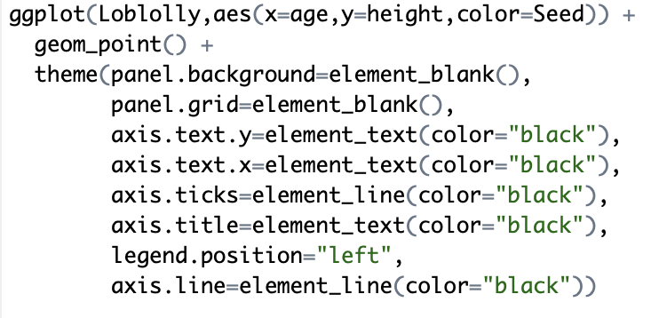
theme()

Slide 30
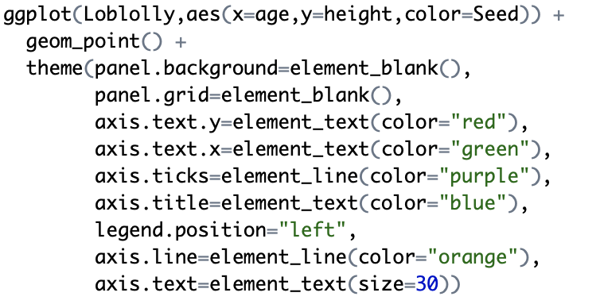
theme()

Slide 31
Yet more stuff...
xlab() & ylab()
X and Y labels
ggtitle()
Plot title
xlim() & ylim()
set limits on the x or y scale
Axis scale transformations
various transformations and limits to x & y scales
specify and change axis labels
Color & fill scales
Define colors and color schemes for line color and fill color

Slide 32
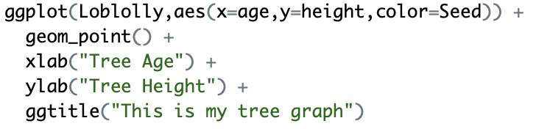
Labels & Titles

Slide 33
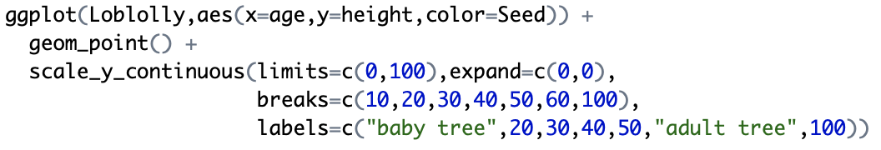
Axis scales & transformations

Slide 34
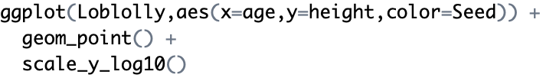
Axis scales & transformations

Slide 35
Color & Fill Scales
Can use to create different combinations of line or fill colors
scale_color_manual()
scale_color_continuous()
scale_color_brewer()
scale_color_discrete()
scale_color_gradient()
etc
swap ”fill” for color to fill in objects
e.g. scale_fill_manual()

Slide 36
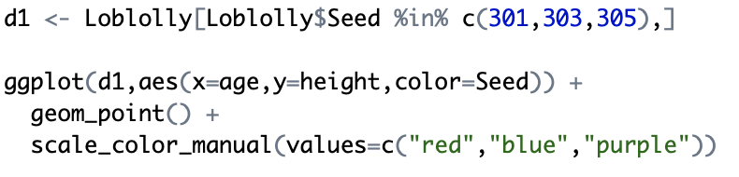
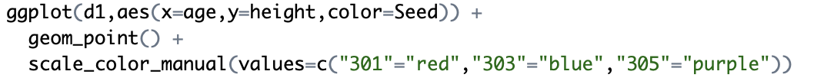
Color & Fill scales

Slide 37
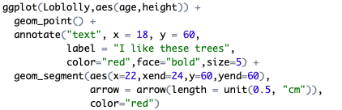
Adding text & annotations

Slide 38
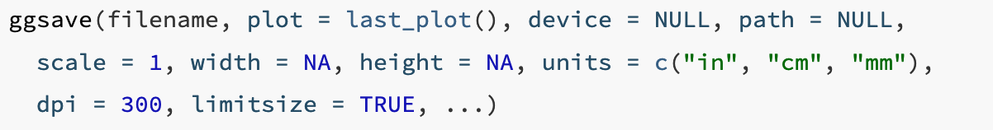
Saving plots with ggsave()
filename = filename
plot = your plot
device = format: pdf, png, etc
path = directory to save

Slide 39
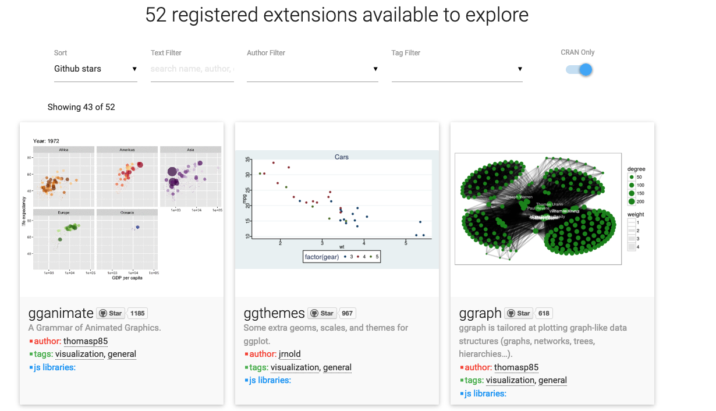
http://www.ggplot2-exts.org/gallery/

Slide 40
Try to create this graph with ggplot2
Will be using data in “gene_metaplot.tsv”
Hint: you will have to manipulate the data frame
library(reshape2)

Slide 41
Code
library(ggplot2)
library(reshape2)
df <- read.table("gene_metaplot.tsv",header=T,row.names=1)
df <- melt(df)
df$Window <- c(1:60)
ggplot(df, aes(x=Window, y=value, color=variable)) + geom_line(size=1) +
theme(panel.background=element_blank(), panel.grid=element_blank(),
axis.text.y=element_text(color="black"), axis.text.x=element_text(color="black"),
axis.ticks=element_line(color="black"), axis.title=element_text(color="black"),
legend.position="right", axis.line=element_line(color="black")) +
ylab("Weighted methylation") +
xlab("") +
scale_y_continuous(limits=c(0,1), expand=c(0,0), breaks=c(0.25,0.5,0.75,1),
labels=c("25%","50%","75%","100%")) +
geom_vline(xintercept=20, linetype="longdash", color="grey55") +
geom_vline(xintercept=40, linetype="longdash", color="grey55") +
scale_x_continuous(labels=c("-2000","TSS","TTS","+2000"), breaks=c(1, 20, 40, 60)) +
scale_color_manual("Context",values=c("blue","red","green"))

Slide 42
Try to create this graph with ggplot2
Will be using data in “subcontext_methylation.tsv”

Slide 43
Code
df <- read.table("subcontext_methylation.tsv",header=T)df2 <- melt(df)df2$context <- row.names(df)df2$order <- hclust(dist((df)))$orderdf2$order2 <- rowSums(df)
ggplot(df2,aes(x=reorder(context,order2),y=reorder(variable,order),fill=value)) + geom_tile() + scale_fill_continuous("Methylation Level",low="blue",high="yellow") + theme(axis.text=element_text(color="black"), axis.text.x=element_text(color="black",angle=315,hjust=-0.2), axis.ticks=element_line(color="black"), plot.title=element_text(hjust=0.5)) + scale_y_discrete(expand=c(0,0)) + scale_x_discrete(expand=c(0,0)) + xlab("Context") + ylab("Sample") + ggtitle("Genome-wide Methylation Level")

